Slide 1

Cost Benefit Analysis - purpose
Cost Benefit Analysis(CBA) was traditionally used by local and national government.
CBA… …is an analysis of the cost effectiveness of different alternatives in order to see whether the benefits outweigh the costs (i.e. whether it is worth intervening at all), and by how much (i.e. which intervention to choose).

Slide 2
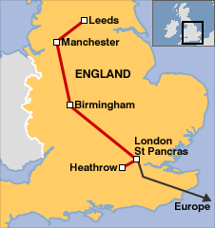

Cost Benefit Analysis - uses
Public sector projects could be railways, roads, training programs or health care systems.

Slide 3
Cost Benefit Analysis - principles
CBA estimates and totals up the various costs and benefits of a project.
So – the first principle has to be: common unit of measurement.
Money is a useful yardstick!

Slide 4
Cost Benefit Analysis – money value
This means that all benefits and costs of a project should be measured in terms of their equivalent.
This can be difficult if costs/benefits are not expressed in terms of pounds.
For example, a public project preserving open space or historic sites can be hard to impute a value.

Slide 5



Cost Benefit Analysis – imputed value
The most challenging part of CBA is to try to put a financial value on intangible costs and benefits. This can be highly subjective – is, for example, a river that is free of pollutants worth £25,000, or is it worth £500,000 because if its environmental importance?

Slide 6
Cost Benefit Analysis – value of human life
Some projects have to value human life – this is difficult.
How would you do it?
Lifetime income?
Priceless?
The cost of reducing a human life?
The payment in wages in jobs where you could lose your life?

Slide 7
Cost Benefit Analysis – decision criteria
If the value of the benefits exceeds the value of the costs then the project is worthwhile.
If there is more than one project that have positive value then the one with the highest value should be chosen!

Slide 8
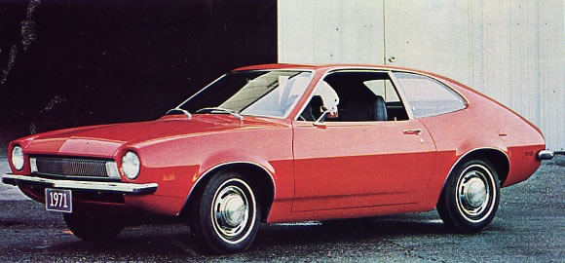
What would you do?
The Ford Pinto
In the case of the Ford Pinto there was a design flaw, the Pinto was liable to burst into flames in a rear-impact collision.
Ford's cost–benefit analysis had estimated that based on the number of cars in use and the probable accident rate, deaths due to the design flaw would run about $49.5 million (the amount Ford would pay out of court to settle wrongful death lawsuits).
This was estimated to be less than the cost of issuing a recall ($137.5 million) .
Ford decided not to issue a recall.
In the event, Ford overlooked (or considered insignificant) the costs of the negative publicity so engendered, which turned out to be quite significant (because it led to the recall anyway and to measurable losses in sales).

Slide 9
Cost Benefit Analysis – Drawbacks?

